Slide 1


USED CAR PRICE PREDICTION
Final Project – 31 Oct 2020
Group 1
Adi Lukmanto
Muhammad Naradi Karim
Yenny Ligninasari
Tutor
Abdullah Ghifari

Slide 2

Overview
In this final project, we will be predicting the price of used cars given the data collected from various sources and distributed across various locations in India.
Data description
Data preprocessing
Exploratory data analysis
Feature Engineering
Model
Conclusion

Slide 3
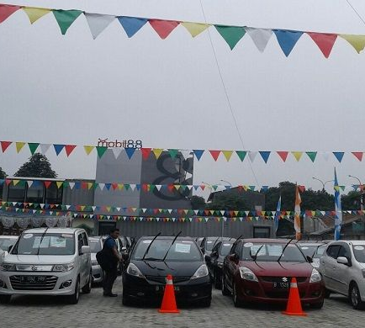
Price Prediction User
To be able to predict used cars market value can help both buyers and sellers.
Used car buyers (dealers)
Online pricing services
Individuals (sellers)

Slide 4
Business Understanding
With a nearly endless amount of data — constantly-evolving market trends and consumer demand, to name a few — it’s hard to parse what used car dealers should pay attention to and what they shouldn’t.
Machine learning contributes to give the fittest feature which influences the customer in purchasing the car which indirectly gives the company or the research market a result in predicting the future sales for cars and boost sales.

Slide 5
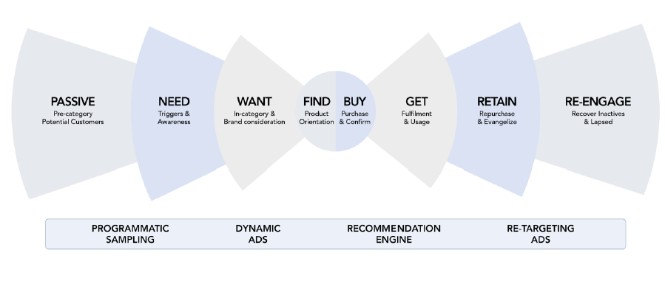
Goal of Machine Learning for Business

Slide 6
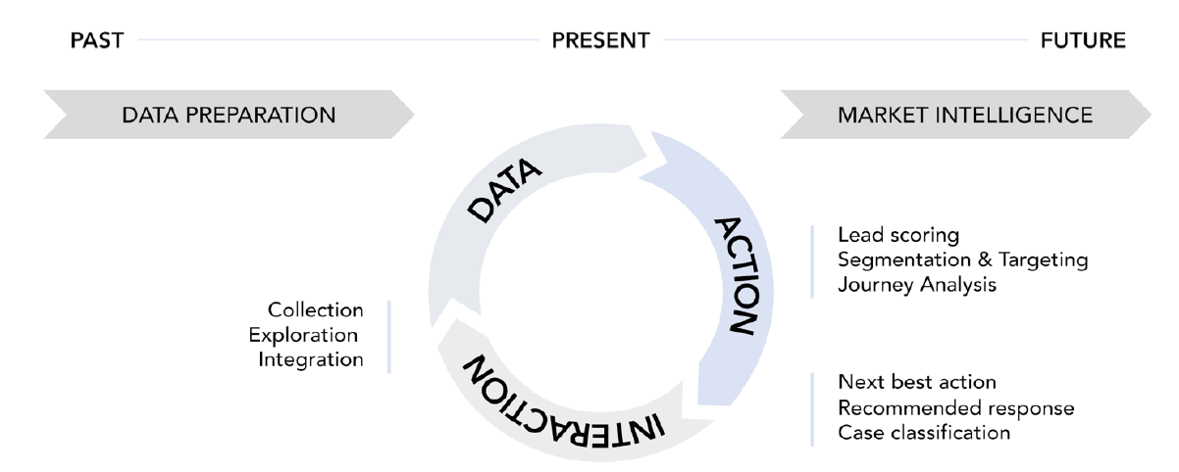
Process of Machine Learning for Business
Three stages of the understand-deliver-measure cycle

Slide 7
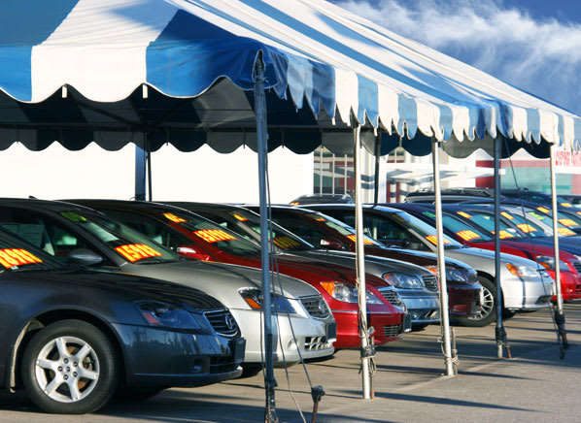
Data Description
Dataset: used_car_data.csv
Source : https://drive.google.com/folderview?id=1cOxWoIfsFRIMYIdCbKvGp9u0mgsbnkch
Dataset has 6019 rows and 12 columns
6019 listings
12 columns, with attributes describing different characteristics of the car listings

Slide 8
Features Description
Following features are given in dataset to make the prediction
Name: The brand and model of the car.
Location: The location in which the car is being sold or is available for purchase.
Year: The year or edition of the model.
Kilometers_Driven: The total kilometres driven in the car by the previous owner(s) in KM.
Fuel_Type: The type of fuel used by the car.
Transmission: The type of transmission used by the car.
Owner_Type: Whether the ownership is Firsthand, Second hand or other.
Mileage: The standard mileage offered by the car company in kmpl or km/kg
Engine: The displacement volume of the engine in cc.
Power: The maximum power of the engine in bhp.
Seats: The number of seats in the car.
Price: The price of the used car in INR Lakhs (INR 100,000)

Slide 9
Data Preprocessing
Separate ‘Car Brand’ and ‘Model’ names in two separate columns
Change ‘Year’ feature to ‘Car Age’
Fill missing and null values for features ‘Mileage’, ‘Engine’, ‘Power’, and ‘Seats’
Convert string to numeric: feature ‘Mileage’, ‘Engine’, and ‘Power’

Slide 10
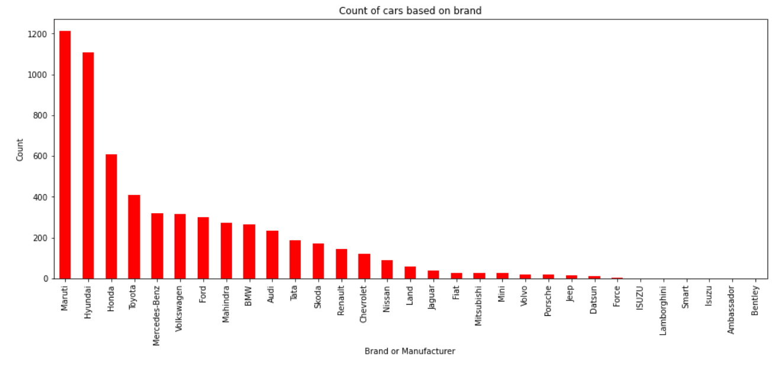
Top Car Brand
Maruti is the leading car brand, followed by Hyundai.

Slide 11
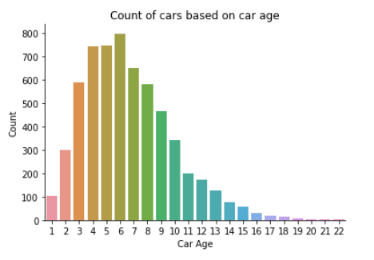
Car Age
Most number of cars in the dataset are built between 2010 to 2017 (age 3-10)

Slide 12
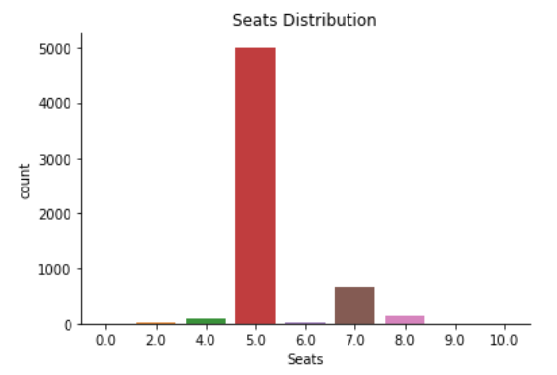
Car Seats
Most of cars in the listing have 5 Seats

Slide 13
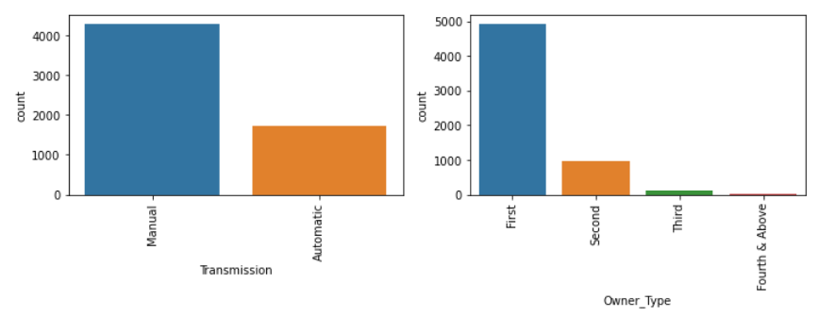
Other features with reference to number of cars
Manual cars are listed more than Automatic cars.
Most of the listed cars are from first hand owners.

Slide 14
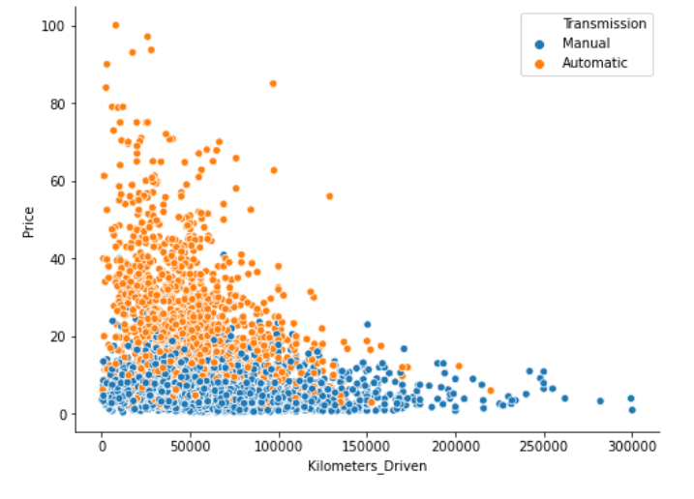
Kilometers_Driven vs Price
Automatic cars are more expensive than manual cars and cars with less Kilometers_Driven also cost more.

Slide 15
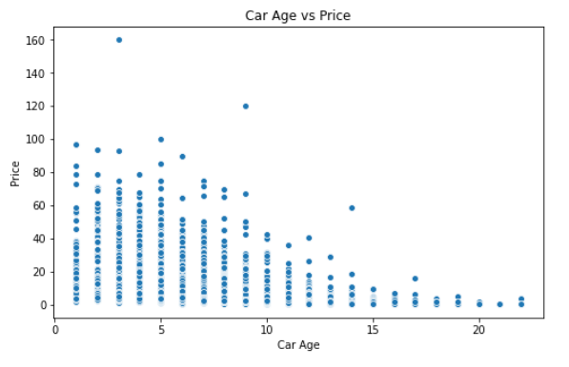
Car Age vs Price
Cars ranging between the years 2012 to 2019 (age 1 – 8) cost more.

Slide 16
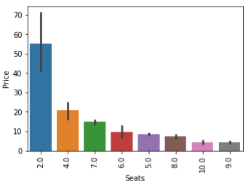
Seats vs Price
Two-seater cars are the most expensive in the listing.

Slide 17
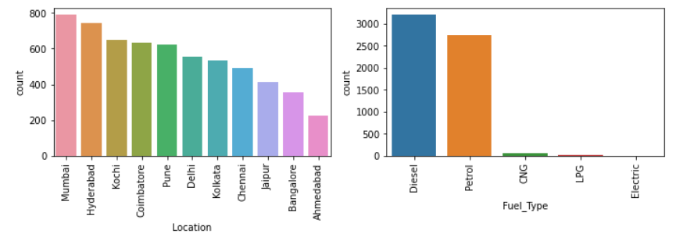
Other features with reference to number of cars (2)
Most of the used cars in the listings are in Mumbai, Hyderabad and Kochi
Diesel and petrol are the most listed fuel types

Slide 18
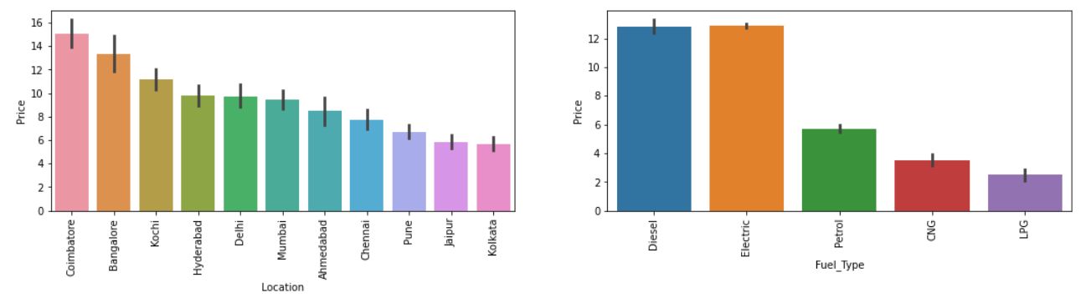
Other features with reference to price
Used cars from Coimbatore have higher price than other cars origin in dataset
Diesel and electric cars are more costly.

Slide 19
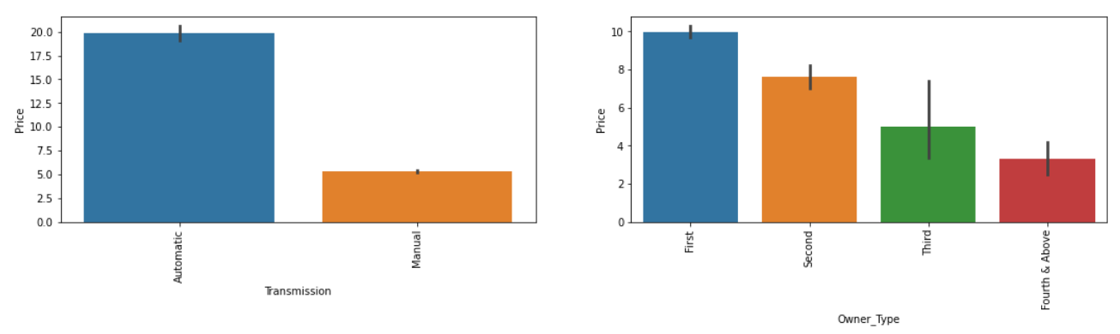
Other features with reference to price (2)
Automatic cars more expensive than manual cars.
First-hand cars are the most costly and followed by second-hand cars.

Slide 20
Feature Engineering
Remove outliers for features 'Kilometers_Driven','Mileage','Engine','Power’, and 'Price’
Delete unnecessary column ‘Model’
Transform feature values using StandardScaler package
Log transform target ‘Price’
Split dataset (70% train and 30% test)
Modelling: using scikit-learn tools

Slide 21
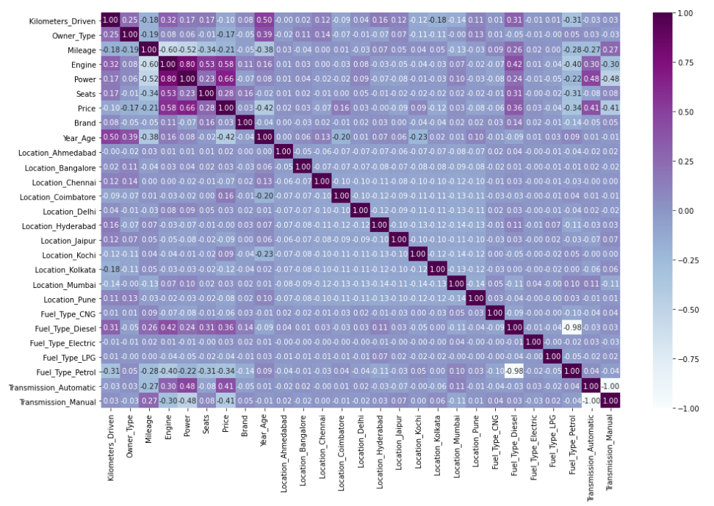
Heatmap: Correlation between features and price

Slide 22
Modelling Summary
Model | MAE | RMSE
Linear Regression | 1.082 | 1.622
Decision Tree Regression | 1.05 | 1.684
Support vector regression | 0.845 | 1.34
Random Forest Regression | 0.775 | 1.187
Note: unit is in INR Lakhs (INR 100,000)

Slide 23
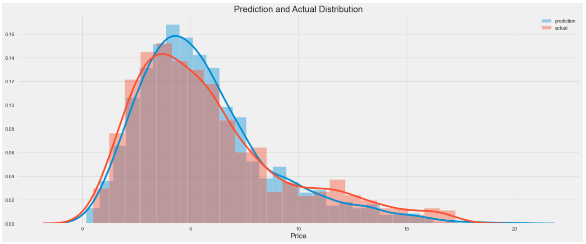
Linear Regression - Prediction on test data

Slide 24
Random Forest Regression
Hyperparameter / Random Search Cross Validation
Using RandomizedSearchCV
Random Hyperparameter Grid
random_grid={'max_depth': [10, 20, 30, 40, 50, 60, 70, 80, 90, 100, None],
'max_features': ['auto', 'sqrt'],
'min_samples_leaf': [1, 2, 4],
'min_samples_split': [2, 5, 10],
'n_estimators': [20, 40, 50, 100, 200, 400, 600, 800, 1000, 1200, 1400, 1600, 1800, 2000]}
Random search of parameters, using 5 fold cross validation, search across 100 different combinations, and use all available cores
Fit the random search model
Best parameters from fitting the random search:
{'n_estimators': 800,
'min_samples_split': 2,
'min_samples_leaf': 1,
'max_features': 'sqrt',
'max_depth': 80}

Slide 25
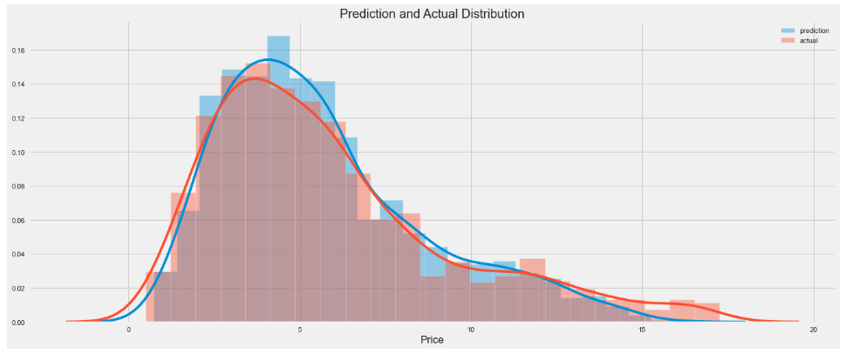
Random Forest - Prediction on test data

Slide 26
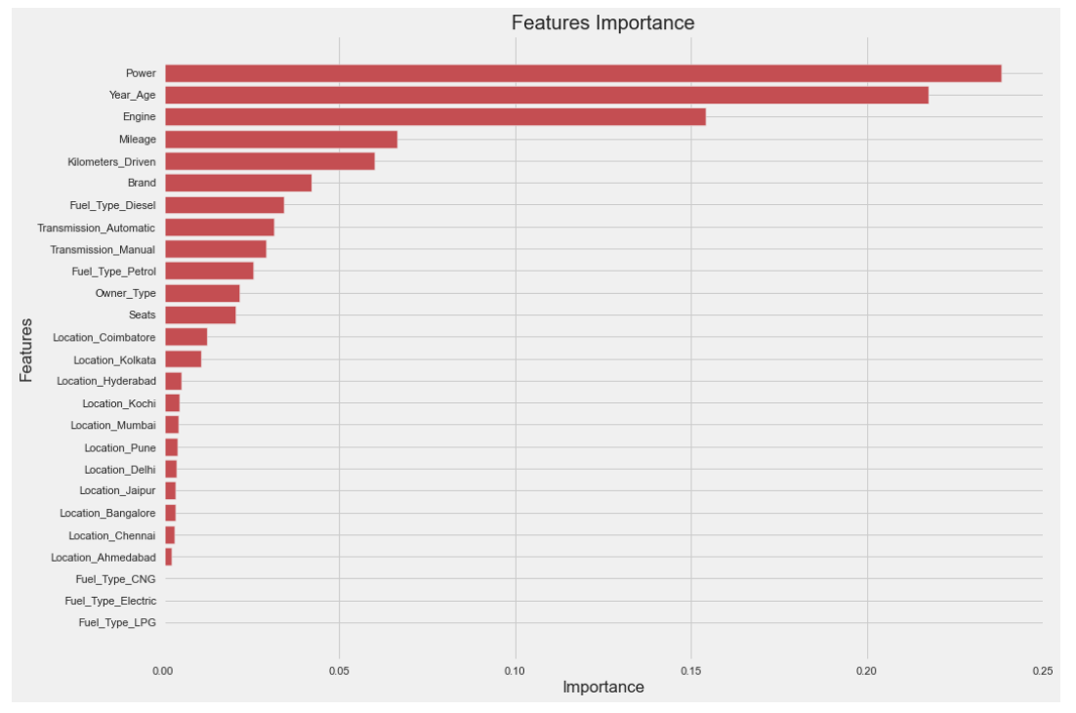
Random Forest - Features Importance

Slide 27
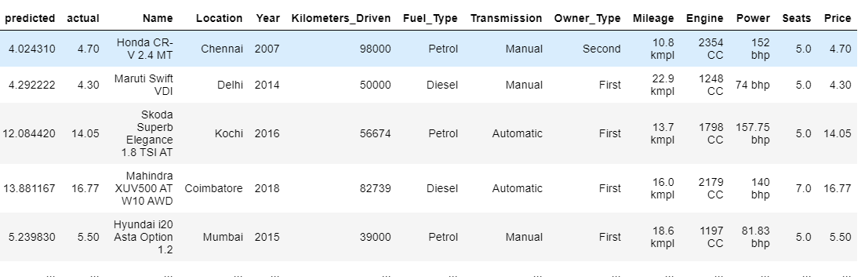
Business Insight
Examples of overpriced used car listings, based on our price prediction

Slide 28
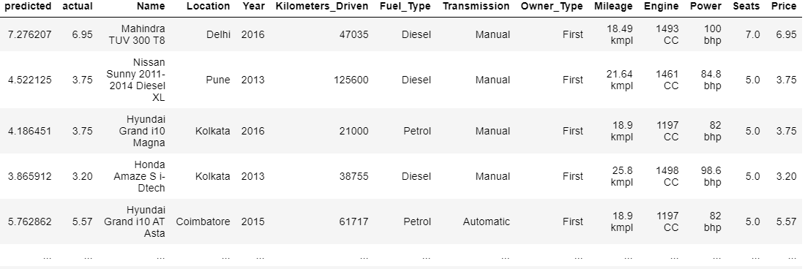
Business Insight (2)
Examples of underpriced used car listings, based on our price prediction

Slide 29
Conclusion
Five top factors that predict Price of used cars are :
Power
Car Age
Engine
Mileage (fuel effice)
Kilometers Driven
Limitation of dataset features:
In future research, we can collect data to explore other factors that influence the sales and sales period of used vehicles. For example wear and tear, sales days, level of discount from the original price, etc. Incorporating these factors in the analysis can improve to choose non-overage vehicles and have a positive impact on profit.

Slide 30
Thank You
FR
FABRIKAM RESIDENCES

Slide 31
Used Car Price Prediction

